Slide 1
Chapter 4 – Requirements Engineering

Slide 2
Topics covered
Requirements engineering processes
Requirements elicitation
Requirements specification
Requirements validation
Requirements change

Slide 3
Requirements engineering processes

Slide 4
Requirements engineering processes
The processes used for RE vary widely depending on the application domain, the people involved and the organisation developing the requirements.
However, there are a number of generic activities common to all processes
Requirements elicitation;
Requirements analysis;
Requirements validation;
Requirements management.
In practice, RE is an iterative activity in which these processes are interleaved.

Slide 5
A spiral view of the requirements engineering process

Slide 6
Requirements elicitation

Slide 7
Requirements elicitation and analysis
Involves technical staff working with customers
to find out about the application domain,
the services that the system should provide and
the system’s operational constraints.
May involve end-users, managers, engineers involved in maintenance, domain experts, trade unions, etc. These are called stakeholders.
Notes:
b

Slide 8
Requirements elicitation

Slide 9
Requirements elicitation
Software engineers work with a range of system stakeholders to
find out about the application domain,
the services that the system should provide,
the required system performance,
hardware constraints, other systems, etc.
Stages include:
Requirements discovery,
Requirements classification and organization,
Requirements prioritization and negotiation,
Requirements specification.

Slide 10
Problems of requirements elicitation
Stakeholders don’t know what they really want.
Stakeholders express requirements in their own terms.
Different stakeholders may have conflicting requirements.
Organisational and political factors may influence the system requirements.
The requirements change during the analysis process. New stakeholders may emerge and the business environment may change.

Slide 11
The requirements elicitation and analysis process

Slide 12
Process activities
Requirements discovery
Interacting with stakeholders to discover their requirements. Domain requirements are also discovered at this stage.
Requirements classification and organisation
Groups related requirements and organises them into coherent clusters.
Prioritisation and negotiation
Prioritising requirements and resolving requirements conflicts.
Requirements specification
Requirements are documented and input into the next round of the spiral.

Slide 13
Requirements discovery
The process of gathering information about the required and existing systems and refine the user and system requirements from this information.

Slide 14
Interviewing
Formal or informal interviews with stakeholders are part of most RE processes.
Types of interview
Closed interviews based on pre-determined list of questions
Open interviews where various issues are explored with stakeholders.
Effective interviewing
Be open-minded, avoid pre-conceived ideas about the requirements and are willing to listen to stakeholders.
Prompt the interviewee to get discussions going using a springboard question, a requirements proposal, or by working together on a prototype system.
Notes:
Springboard question: something that helps you start an activity or process. The news served as a springboard for a class discussion.

Slide 15
Interviews in practice
Normally a mix of closed and open-ended interviewing.
Interviews are good for getting an overall understanding of what stakeholders do and how they might interact with the system.
Interviewers need to be open-minded without pre-conceived ideas of what the system should do
You need to prompt the use to talk about the system by suggesting requirements rather than simply asking them what they want.

Slide 16
Problems with interviews
Application specialists may use language to describe their work that isn’t easy for the requirements engineer to understand.
Interviews are not good for understanding domain requirements
Requirements engineers cannot understand specific domain terminology;
Some domain knowledge is so familiar that people find it hard to articulate or think that it isn’t worth articulating.

Slide 17
Stories and scenarios
Scenarios and user stories are real-life examples of how a system can be used.
Stories and scenarios are a description of how a system may be used for a particular task.
Because they are based on a practical situation, stakeholders can relate to them and can comment on their situation with respect to the story.

Slide 18
Scenarios
A structured form of user story
Scenarios should include
A description of the starting situation;
A description of the normal flow of events;
A description of what can go wrong;
Information about other concurrent activities;
A description of the state when the scenario finishes.

Slide 19
Example: Usage Scenario
A simple example is one for an ATM machine. The ATM Customer wishes to withdraw cash as follows:
The ATM Customer realizes that he needs some cash but is nowhere near a bank, so he goes to a convenient ATM nearby to get it. He identifies himself to the ATM and specifies that he wants $100 from his checking account. He indicates that he doesn’t need a record of the transaction or his current balance. He takes his cash when delivered.

Slide 20
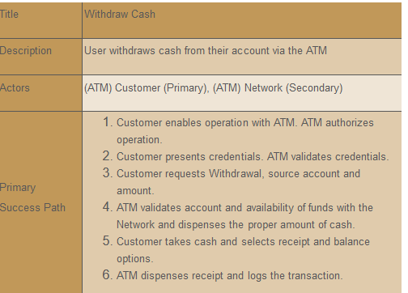
Use Case

